Slide 1
Somatic Mutation Calling

Slide 2
Goals and learning outcomes
Develop a basic understanding of how to perform variant calling
Deeply understand the workflow for variant calling
Start developing an intuition for working with variant calls
Every study will be different, so hard rules aren’t useful
Every study will require critical thought - I want you to leave with a sense for how to ask the right questions, rather than give you the right answers (there are no right answers!).
Learn common metrics used for quality control of tumors and their importance
Cancer Cell Fraction, Variant Allele Frequency, Tumor Purity, Copy Number, Contamination

Slide 3
Human mutation
Mutations are:
Changes in the DNA
Caused by exogenous or endogenous processes
Sometimes but not always heritable
Types of mutation:
Single nucleotide variants (SNVs)
Somatic simple variants (SSVs)
Insertion-deletion variants (indels)
Structural variants (SVs)

Slide 4
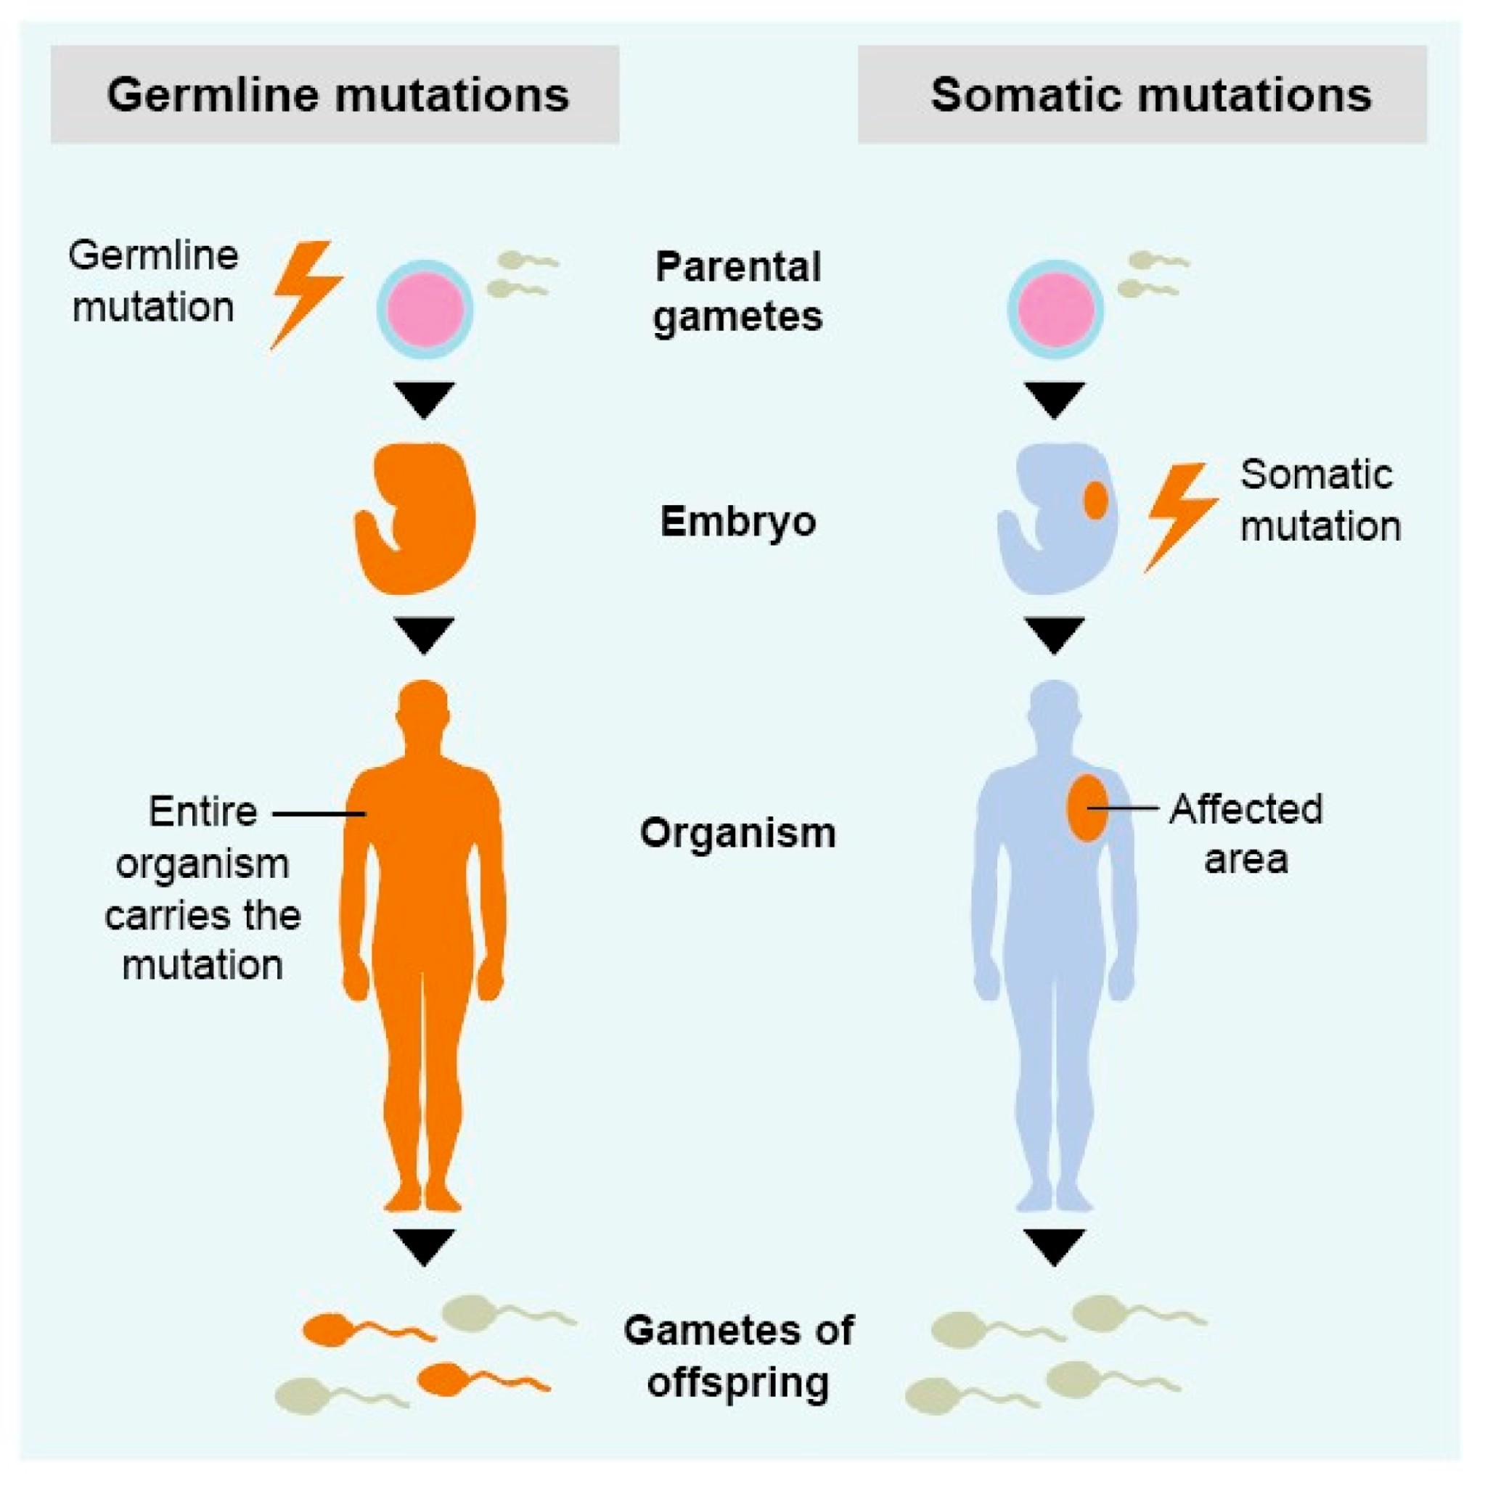
Somatic mutations
Somatic mutations occur in cells after conception which do not belong to the germline.
Somatic mutations may occur in almost any cell in the body.
Somatic mutations are never passed on to future generations.
https://www.mdpi.com/1422-0067/22/1/336/htm

Slide 5
Calling mutations in sequencing reads
Mutations are called relative to a reference genome
Every human differs every ~1000bp compared to the reference (“variation”)
“Mutation” term is often reserved for variants with impact (e.g. driver mutations)
To call somatic mutations, a variant caller does the following:
Determine if a given site differs from the reference in the tumor and normal separately
Determine the allele and genotype of the site in the separate tumor / normal
Classify the site as “germline” or “somatic” by filtering any sites observed in both the tumor and normal
Sites that are observed in the tumor, but not the normal, are considered somatic variants.

Slide 6
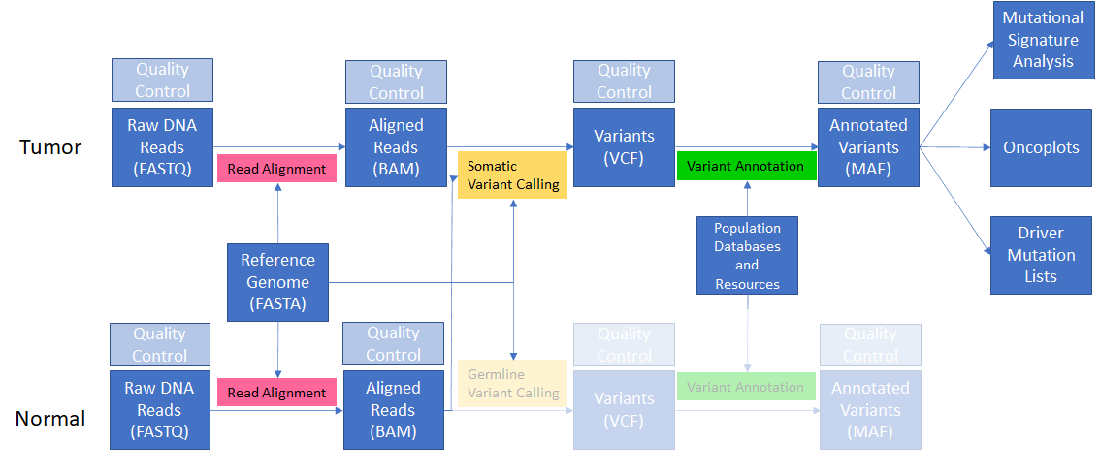
Read alignment
Review from yesterday:
Notes:
Remember from yesterday that we can’t do much with our raw FASTQ reads - we need to align them to the genome to have a meaningful understanding of what the genome of our tumor and normal actually look like.

Slide 7
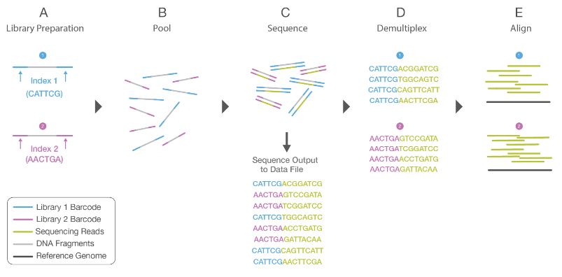
Read alignment
Remember - we have no idea where in the genome our FASTQ reads came from!
We can only sequence small (150bp) portions of the genome
We must “shatter” the DNA into sequenceable pieces (but these are random bits of DNA)
Notes:
Image from https://www.illumina.com/content/dam/illumina-marketing/documents/products/illumina_sequencing_introduction.pdf

Slide 8
Read alignment
In read alignment, we probabilistically assign the random DNA fragments (“reads”) to a position within the reference genome.
CHR1
Align reads
CHR2
Reference genome w/ aligned reads
For a full discussion of sequence alignment, see: https://github.com/WCSCourses/NGS_Bio_Africa/blob/main/Modules/Module_4_Alignment_to_Reference/read-alignment.lecture_slides.20210504.pdf

Slide 9
Read Alignment
We perform the following conceptual procedure to align a single read (using BWA mem):
Search the reference genome for the longest shared sequence(s) in both the read and the reference
Record the positions for these maximal-exact matches (MEMs)
For each MEM above some length, perform Smith-Waterman alignment between the flanking sequences of the read / reference at the MEM
Generates the optimal alignment between two sequences
Provides us a score to judge the best alignment
The output of this process is a BAM file containing alignments.

Slide 10
Read Alignment - Reference Bias
When we align reads, we penalize mismatches (SNPs and indels) relatively to the reference (that is, reads that perfectly match the reference score higher than those with variants).
But humans all vary from the reference.
This leads to reference bias - samples that are more like the human genome (which is largely of European ancestry, and 70% derived from one individual in Buffalo, NY) will have more accurate alignments and variant calls.
In addition - most databases are overwhelmingly filled with samples of European ancestry, so we continue to reinforce such bias downstream.

Slide 11
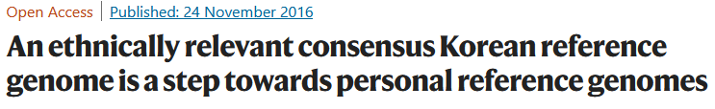
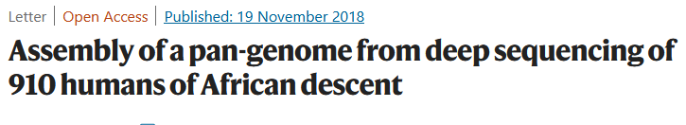

Read Alignment - Reference Bias
What are some things being explored to reduce reference bias?
Databases that include samples of diverse ancestry
NIH All of Us, Simons Genome Diversity Project, many national-level sequencing initiatives.
Population matched references
Useful for improved germline and somatic calls
HOWEVER, using one makes it difficult to use existing databases (so not a great answer)
Pangenomes
Pangenomes collect multiple genomes within a single data structure - imagine a reference that contains sequences/variation from many humans.
Over time, the field is migrating to these to address issues of inclusion in genomic studies.
Tools for using pangenomes exist and are growing in usage but not yet widespread.
For more information, see: https://humanpangenome.org/

Slide 12
Variant calling
Our aligned reads will have variation relative to the reference. When we call variants, we probabilistically assign alleles and genotypes to these variations based on the evidence provided by our alignments
Rules of thumb:
humans have a germline mutation on average every 1000 bp (99.9% identical)
SNPs are roughly 10x more frequent than indels (except in hypermutator genotypes like Microsatellite Instability)
While each tumor has a unique number of mutations, within each cancer type the number of observed somatic mutations is often remarkably consistent (e.g. in thyroid cancer hundreds of mutations, in colon cancer 1000s, etc.)
GAATTGGTCAAAAAT
CAAAAAT-CTTA
Aligned read(s):
TGGTCAAAAAT-C
Reference:
ACTGGAATGGCCAAAAATGCTTAAGGCCTTATGGAAATGGAATCCACCA

Slide 13
What types of variants might we find?
Single-nucleotide variants
Mutation substitutes a single basepair (e.g., C->T)
Multi-nucleotide variants
Two or more adjacent nucleotides are substituted (e.g. CC->TT)
Insertion-deletion variants
One or more nucleotides are inserted into or deleted from the reference (e.g. AATTGGCC -> AAT-GGCC and AATTGGCC -> AATTTTTGGCC)
Structural variants
Large (>50bp) changes to the genome that may alter copy number, orientation, chromosomal organization, etc.

Slide 14
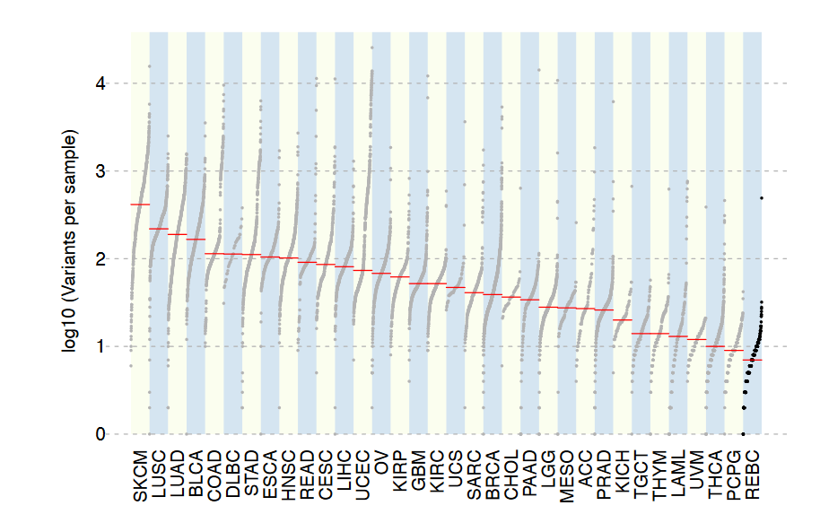
Somatic SNVs and Indels
Somatic single-nucleotide variants (sSNVs) and indels are sometimes collectively referred to as SSVs (simple somatic variants)
Every tumor will have some, but total count (“mutation burden”) can vary both within and across cancer types.
Generally, tens to tens-of-thousands of somatic mutations (vs. millions of germline variants)

Slide 15
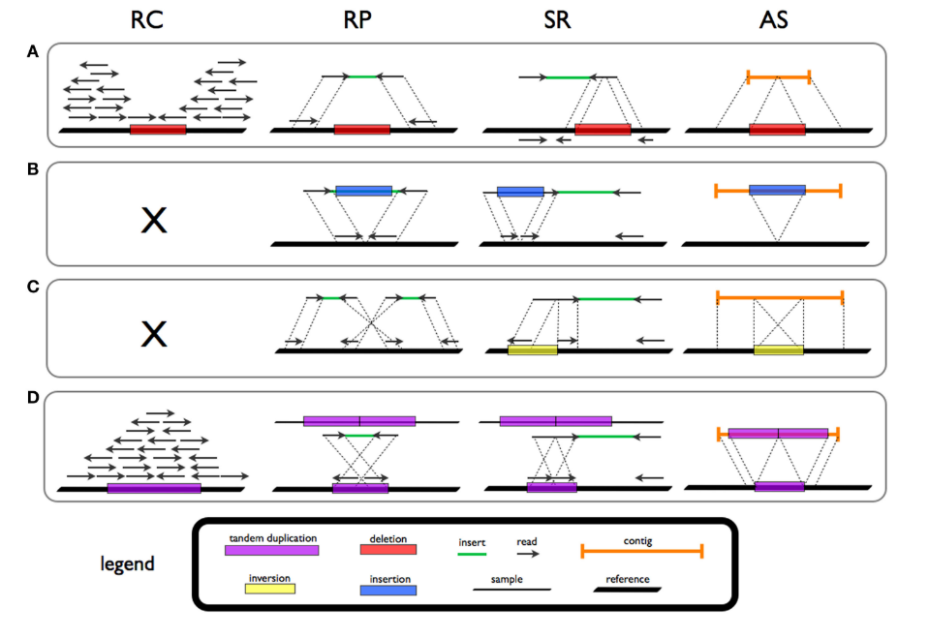
Structural variants
Structural variants are large (>50bp) alterations within the genome
Hard to detect in short reads
Historically undersurveyed in short-read studies
Occur more rarely than SSVs, but affect more basepairs of sequence
Incredibly powerful impacts on genome
Gene Fusions
Promoter swapping
Chromothripsis, kataegis, etc.
Short read callers: delly, lumpy, Manta, svaba
Long read callers: SNIFFLES2, PBSV
Types of structural variants and various evidence types (from Tattini et al 2015.)

Slide 16
Variant calling software
Variant callers use various mathematical methods to generate variant calls, genotype calls, and quality metrics (e.g., Genotype Quality)
Heuristic methods
Bayesian probability
Deep learning
There are probably hundreds of germline and somatic variant callers, but some of the most popular are:
Germline: GATK HaplotypeCaller, DeepVariant, bcftools, strelka2
Somatic: GATK mutect2, strelka2, MuSE, loFreq
Often, running multiple variant callers produces better results than a single caller (see the GDC pipeline for an overview of one such approach)
Notes:
We will focus our attention on mutect2 in the following slides on somatic variat calling, as it is popular, full-featured, and sensitive / precise

Slide 17
MuTect2
MuTect2 is a somatic variant caller that 1. Leverages the assembly approach of HaplotypeCaller 2. Applies a Bayesian classifier to detect low-allele fraction mutations 3. Uses a set of strict filters to increase specificity
Originally published in 2013
Pros:
Written in Java, so installation is easy (and it’s included as part of the GATK)
Widely used
Repeatedly validated in studies and competitions
Cons:
Very slow (but accelerated alternatives available)

Slide 18
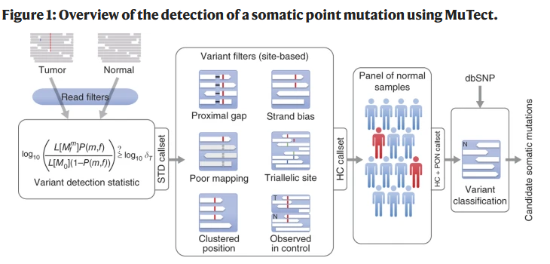
Mutect2
Prefiltering
Bayesian Classifier
Post
filtering
Population / database postfiltering (optional, but very powerful)

Slide 19
Mutect2
Basic usage:
gatk Mutect2 \
-R reference.fa \
-I tumor.bam \
-I normal.bam \
-normal normal_sample_name \
-O somatic.vcf.gz

Slide 20
Panel of Normals
We often use a panel of normal samples (or PON) to remove germline mutations from our somatic calls.
PONs can be generated either from population databases OR from the normal samples within your study
Population PONs tend to contain more samples / variants, so you can remove more common variants
Often 1000Genomes, gnomAD, or Simons Genome Diversity Project
Study-matched PONs are more specific to your population, so they’re useful particularly for populations that aren’t well represented in databases.

Slide 21
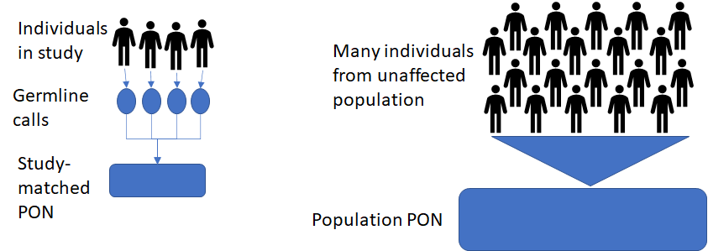
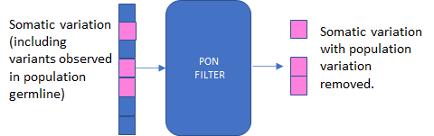
Mutect2 - Panel-of-Normals (PON)

Slide 22
Mutect2
Usage with germline resource + PON:
gatk Mutect2 \
-R reference.fa \
-I tumor.bam \
-I normal.bam \
-normal normal_sample_name \
--germline-resource af-only-gnomad.vcf.gz \
--panel-of-normals pon.vcf.gz \
-O somatic.vcf.gz
Creating a PON:
Call normal samples in tumor-only mode
Create a PON using mutect
or
Download a public PON

Slide 23
Mutect2
Tumor-only mode (used to create PON):
gatk Mutect2 \
-R reference.fa \
-I sample.bam \
-O single_sample.vcf.gz
Tumor only mode with PON + germline resource (for when you don’t have a matched normal):
gatk Mutect2 \
-R reference.fa \
-I sample.bam \
--germline-resource af-only-gnomad.vcf.gz \
--panel-of-normals pon.vcf.gz \
-O single_sample.vcf.gz

Slide 24
Mutect2 outputs
A VCF file of somatic variant calls
Important fields: DP, GQ, GT, VAF
Useful options:
--annotations <annotation> : add fields like DP (depth) to output
--annotation-group <annotation group> : add groups of fields to output
--native-pair-hmm-threads : improve performance slightly

Slide 25
Mutect2
Mutect2 is very slow. Some ways to speed it up:
Split analysis across genomic intervals (standard way)
Add more threads (slight boost)
Use an accelerated version (e.g., Nvidia Clara Parabricks, Sentieon, etc.)

Slide 26
Running Mutect2 in the cloud
If you don’t want to run Mutect2 locally, you can run all of these analyses in the cloud (for example, in Broad’s Terra system: https://terra.bio/)
No need for a high-performance compute center
Optimized pipelines
Pay-per-use
However, the cloud can be very expensive - make sure to understand the cost model before running things, and consider if it’s cheaper to run on your university resources.

Slide 27
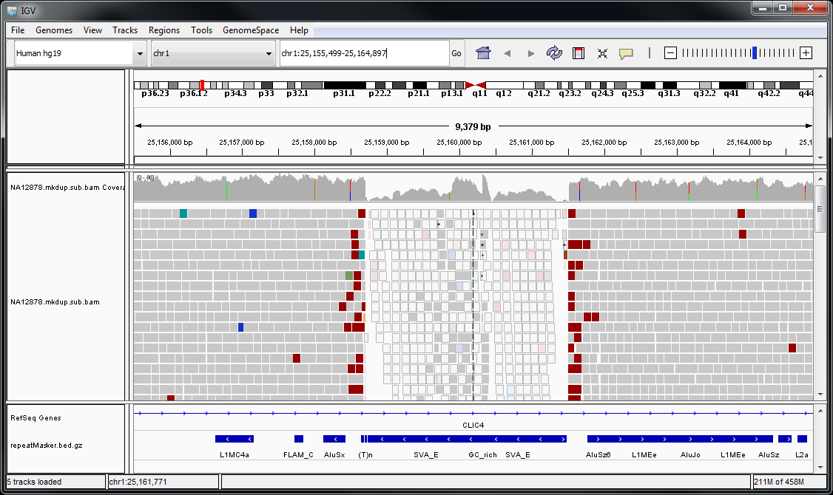
Integrated Genomics Viewer (IGV)
IGV is a program for viewing alignments (https://software.broadinstitute.org/software/igv/)

Slide 28
IGV
Select Genome
Zoom
Current window location
Coverage
Track
Read
Track
Annotation
Track

Slide 29
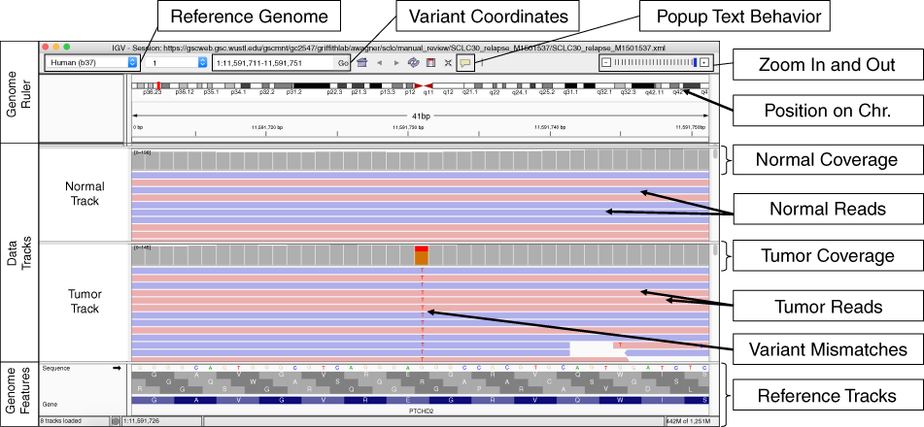
IGV
Useful paper:https://www.nature.com/articles/s41436-018-0278-z

Slide 30
Variant annotation
Variant calls alone tell us only where a variant occurred in the genome and the allele / genotype.
To assess a variant in the context of cancer, we want to know:
Its frequency in the unaffected population
Its frequency in cancer cases (from tumors of same/different type)
Its possible impact on gene expression
Its possible impact when translated to protein
Any association to disease
We annotate variants to link our calls with such information

Slide 31
Variant annotations
Where do annotations come from?
Gene and transcript databases (ENSEMBL, UCSC)
Population databases (1000Genomes, dbSNP, COSMIC, PCAWG)
Impact prediction software (CADD, REVEL, dbNSFP)
Manual annotation (ClinVar, BRCA Exchange)

Slide 32
How do we annotate variants?
We use annotation software, which adds fields to our data
Examples:
Variant Effect Predictor (VEP)
Funcotator
VCF2MAF
Vcfanno
SNPSwift
Output: VCF or MAF (both tab-delimited files)

Slide 33
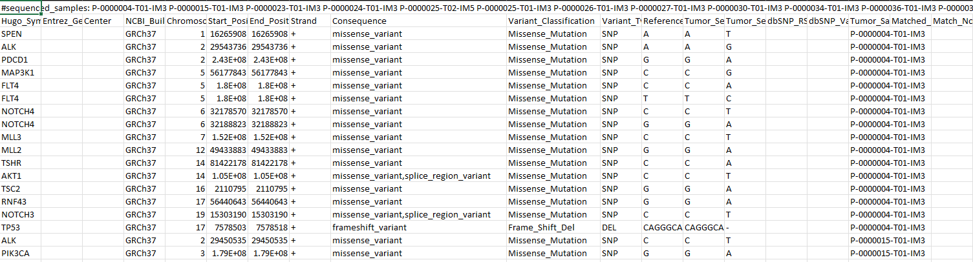
Annotation - important fields

Slide 34
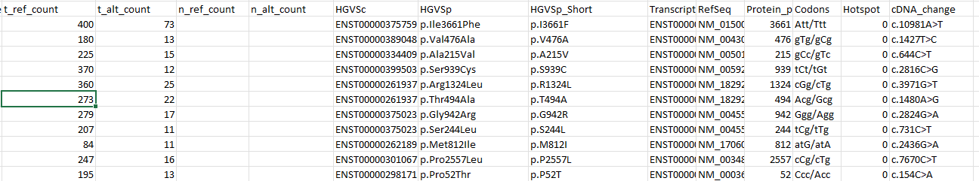
Annotation
More useful MAF columns:
Q: What do we do once we have annotated variants?
A: All the analyses we can actually publish!

Slide 35
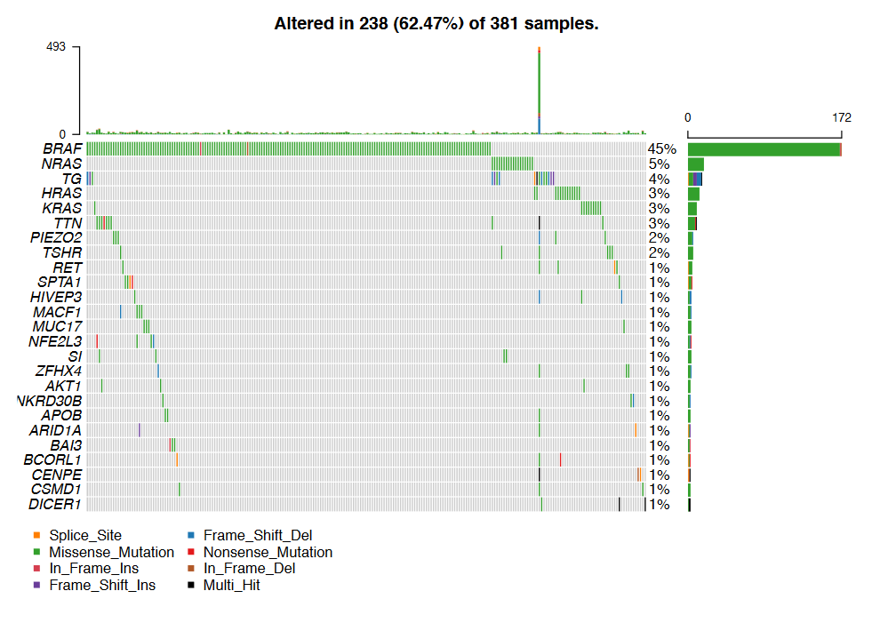
Annotation -> oncoplots
From Dawson 2020

Slide 36
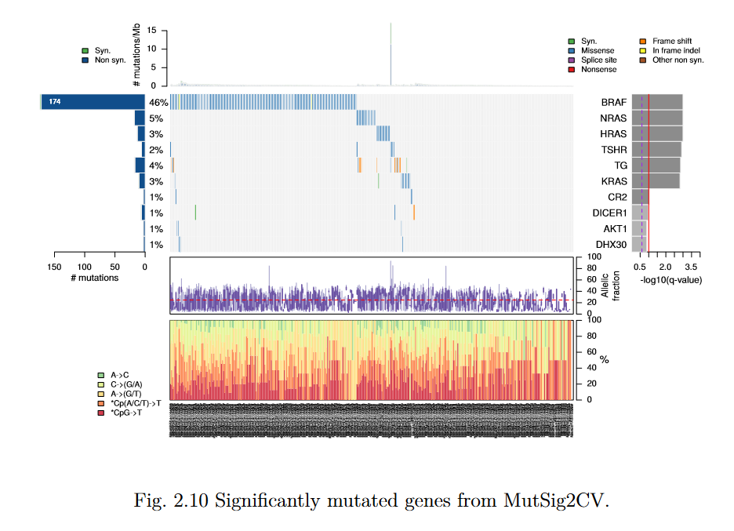
Annotation -> significantly mutated genes
From Dawson 2020

Slide 37
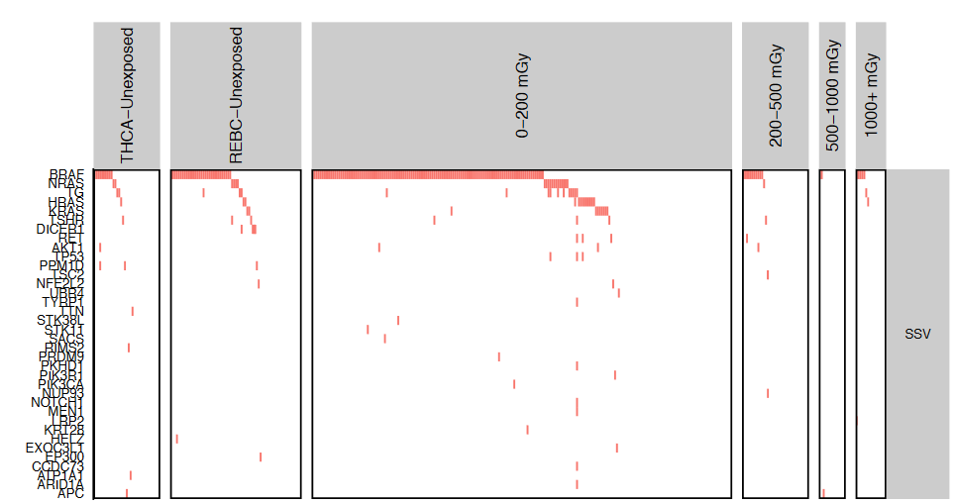
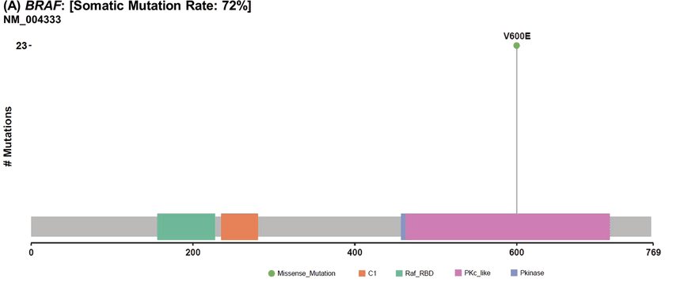
Annotations -> driver mutations
Modified from: https://link.springer.com/article/10.1007/s12020-019-01842-y
From Dawson 2020

Slide 38
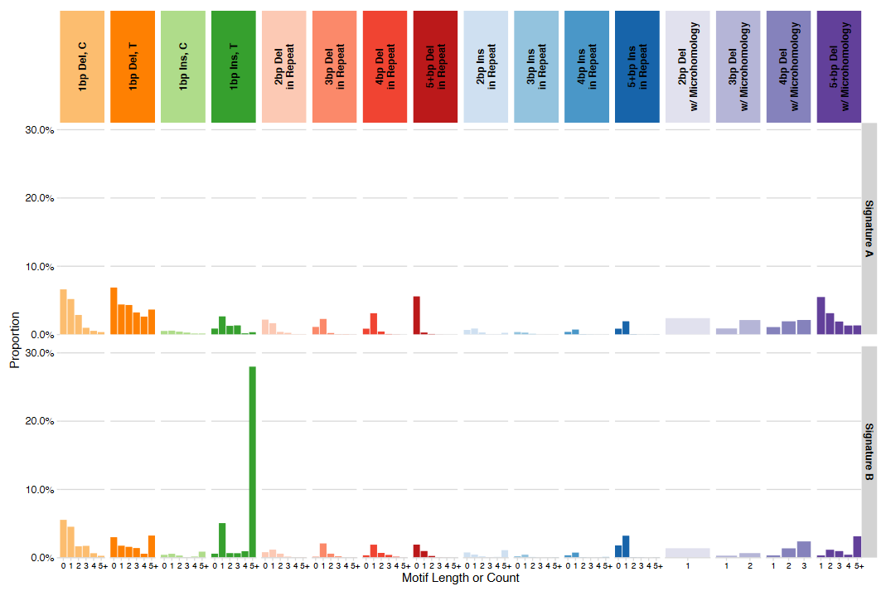
Annotations -> mutational signatures
From Dawson 2020

Slide 39
VAF, CCF, Tumor Purity, Copy Number, and Contamination
Tumors are complex, bulk mixtures of cells
Tumors continue to mutate while under constant evolutionary pressure
Significant benefits for developing faster growth, immune evasion, angiogenesis and other hallmarks of cancer (more about this in the Driver Mutations lecture)
May be composed of multiple subclones with complex architecture
A tumor is a cellular mixture of (sub)clones with various genetic mutations over a common background; normal cells; immune cells; etc.
Resected tumor

Slide 40
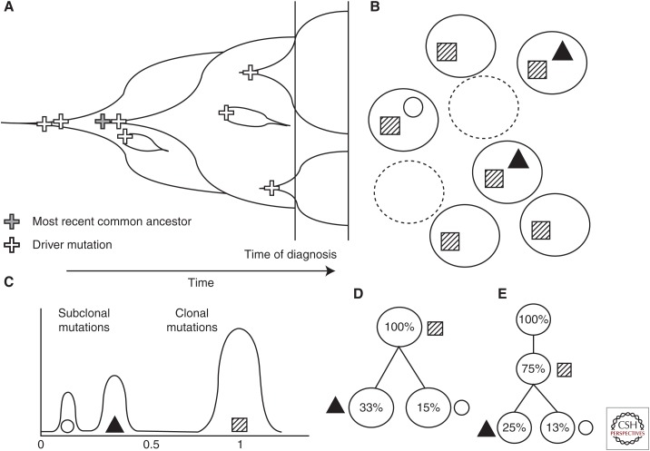
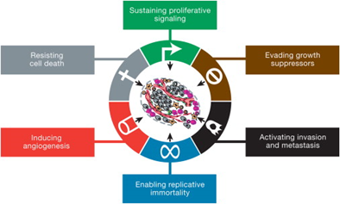
Tumor evolution
https://www.ncbi.nlm.nih.gov/pmc/articles/PMC5538405/

Slide 41
VAF: Variant Allele Frequency
The proportion of reads supporting a given allele at a site:
VAF = # Reads supporting alt
(# reads supporting alt) + (# reads supporting reference)
Simple! Except:
Not all tumor cells will contain a given mutation
Tumors are contaminated with normal cells
Copy number changes can change the ratio of alleles
Therefore, we can’t rely on VAF as an accurate descriptor of a tumor’s mutations (as we can for germline)

Slide 42
Tumor purity
Tumor purity: the percentage of cells in the “tumor” sample that are actually from the tumor.
We can’t extract tumors cell-by-cell - there is always some level of normal cell infiltration
Tumor purity: 18 / 23 ~78% (pretty good!)
Typical purity range: 20%-80%
Resected tumor
(Total cells: 23
total tumor cells: 18)

Slide 43
Cancer cell fraction (CCF)
CCF: the proportion of cells within a tumor containing a given variant
Think of this as an allele fraction weighted to cells within the tumor
CCF = 1.0: all cells in the tumor have this mutation (“clonal”)
CCF = < 1.0: some proportion of cells in the tumor have this mutation (“subclonal”)
Common subclonal VAFs: 0.5, 0.33 (think of dividing the tumor)
Resected tumor
(total tumor cells: 18)
CCF = 5 / 18 = ~0.33 (subclonal)
CCF = 18 / 18 = 1 (possible driver)
CCF = ?? = ?? (clonal or subclonal?)

Slide 44
Contamination
Technical contamination from another sample (happens much more often than you might think)
Tumor-in-normal
contamination
Normal cell contamination
In tumor
Resected tumor

Slide 45
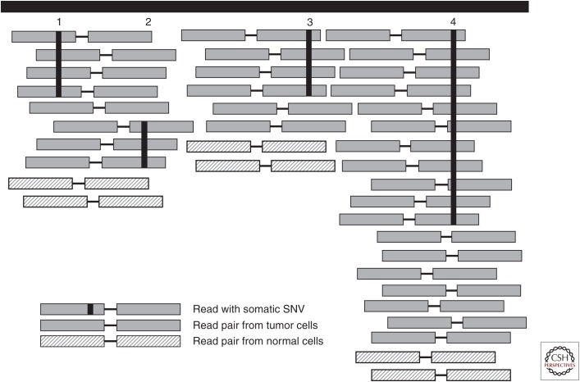
Copy number variation
Copy number = 1
(Ploidy = 2)
Copy number = 2
(Ploidy = 4)
Distorted VAF / CCF
Original CCF: 0.5
Original VAF: 0.5
One haplotype duplicated -> new VAF ~0.66
If you observe CCFs not divisible by 2, and your tumor is relatively pure, consider looking at copy number (e.g. with ASCAT)

Slide 46
Conclusions

Slide 47
Conclusions
If you just want to get SSV calls: BWA mem + MuTect2
Variant calls are almost useless without annotation
Filter your calls extensively
Tumors are complex, and somatic calling is fraught with error
Be careful, think statistically, and consider common sources of error
Expectations from one study (e.g., SSV burden) may or may not apply in others

